Slide 1
DR.M.P.LAL PROFESSOR AND HEAD , DEPT OF SURGERY
ERRORS OF REFRACTION

Slide 2
EMMETROPIA
It is the normal condition of the eye. There is no error of refraction.
The average power of a normal emmetropic eye is +58 to +60 D

Slide 3
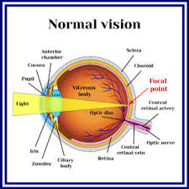
Normal vision

Slide 4
Errors of refraction
The optical condition of the eye in which the incident parallel rays of light do not come to a focus upon the light sensitive layer of the retina , with accommodation at rest is known as ametropia.

Slide 5
ETIOLOGY OF AMETROPIA
Axial ametropia
Curvature ametropia
Index ametropia
Abnormal position of lens

Slide 6
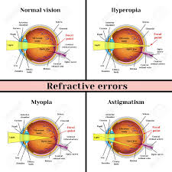
Ametropia

Slide 7
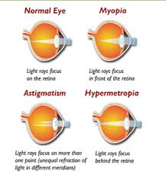
Ametropia

Slide 8
MYOPIA(SHORT SIGHTEDNESS)
TYPES-
a. Congenital
b. Simple
c. Pathologic
d. Acquired

Slide 9
HYPERMETROPIA(FAR SIGHTEDNESS)
TYPES
1.Latent
2.Manifest
a. Facultative
b . Absolute

Slide 10
ASTIGMATISM
TYPES
1.Regular
a. Simple
b. Compound
c . Mixed
2. Irregular

Slide 11
CORRECTION OF AMETROPIA
SPECTACLES
CONTACT LENS
Hard lens
Soft lens
Gas permeable lens

Slide 12
REFRACTIVE CORNEAL SURGERIES
Radial keratotomy
Photorefractive keratectomy
Laser – assisted in situ keratomileusis
Laser sub epithelial keratomileusis and Epi-LASIK
Clear lens extraction with posterior IOL
Intracorneal Ring Segments
Phakic IOL and Implantable Contact Lens

